Slide 1
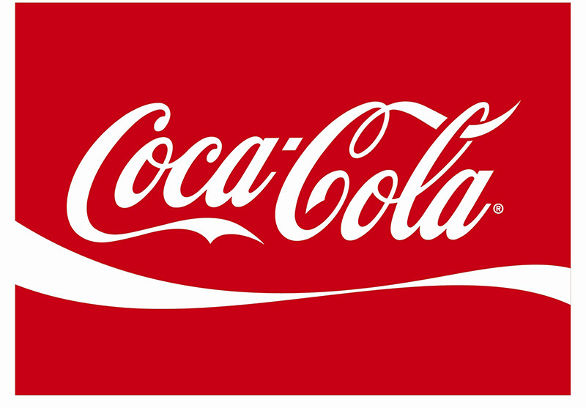
Coca Cola - famous world brand
Artur Vareljyan

Slide 2
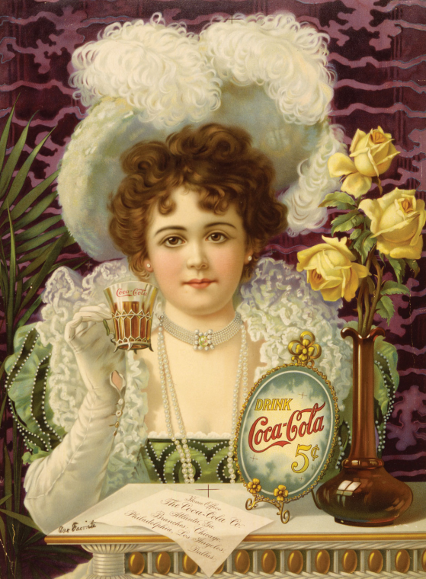
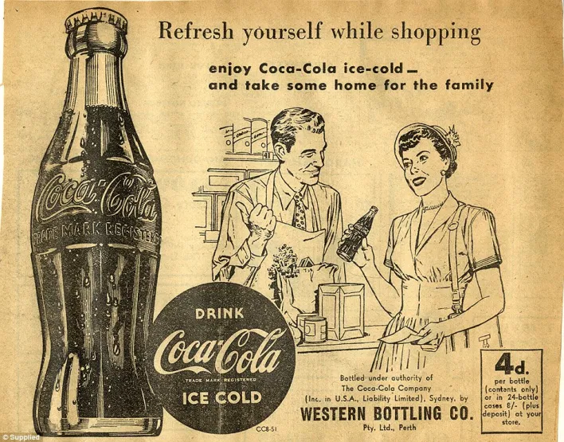
History
Invented in July 1886
Invented by pharmacist John Stith Pemberton
Advertised as helpful in the relief of headache

Slide 3
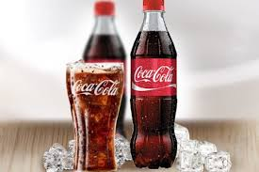
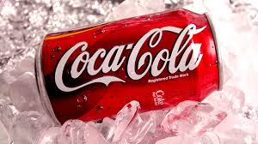
History
In 1889, American businessman Asa Griggs Candler purchased the Coca-Cola formula and brand
In 1892, the Coca-Cola Company was formally founded in Atlanta.

Slide 4
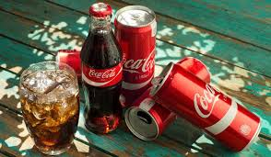
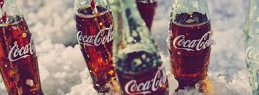
Interesting facts
The Coca-Cola has around 4,000 different drinks across 500 brands. In fact, Coca-Cola makes so many products, if you tried one product from its portfolio every day, it would take you just under 11 years to try them all.
The 1980s was a particularly exciting time for the brand, with Coca-Cola becoming the first soft drink to be consumed in space.

Slide 5
Interesting facts
Coca-Cola's name comes from the coca plant and the kola nut
The first Coke was red wine mixed with cocaine
Coca-Cola was the first Olympic sponsor
Coca-Cola is the most widely distributed product on the planet
Mexicans drink more Coke than any other country in the world.
Coke sold 25 bottles its first year. Today, it sells 1.8 billion bottles—per day.

Slide 6
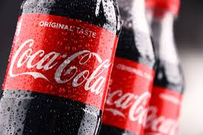
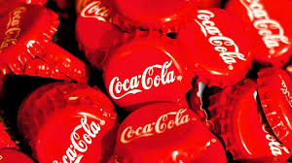
Interesting facts
In Japan you can enjoy alcoholic Coca-Cola
The famous bottle was originally shaped like a cocoa bean.

